Slide 1
The Baseline: What We Know from the Research
Moderator – John Greacen, Greacen Associates, LLC
Client Demand – Natalie Knowlton, Institute for the Advancement of the American Legal System
Lawyer Usage – Sara Smith, ABA Standing Committee on the Delivery of Legal Services

Slide 2
A Whole New World They Are Voting With Their Feet

Slide 3
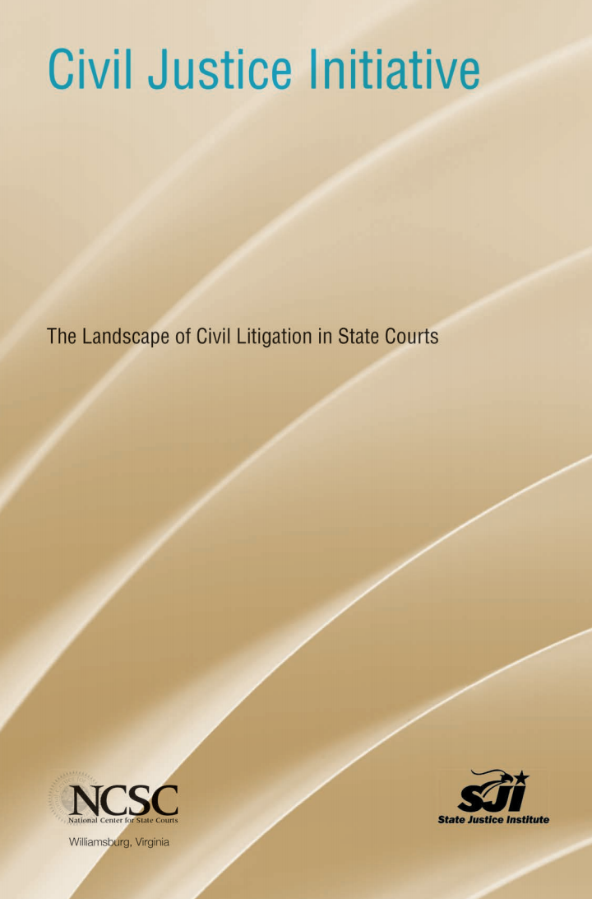
NCSC The Landscape of Civil Litigation study found …
Of almost 1 million state court civil cases, only 8% of civil filings are tort or real property cases; most are debt collection, landlord/tenant, contract, foreclosure, and small claims matters.
Only 0.2% had judgments for $500,000 or more; 75% had judgments for less than $5,200.

Slide 4
NCSC The Landscape of Civil Litigation study found …
Defendants are represented in only 2% of small claims, 21% of contract matters, 33% of “other” civil matters, 41% of real property matters, and 64% of tort cases.
Plaintiffs are represented in over 95% of contract, tort, and real property cases, in 80% of “other” civil cases, and in 68% of small claims cases.
V.
76% of cases involved at least one self-represented party

Slide 5
NCSC 1992 vs. 2015 Surveys of Non-family Civil Cases
% of Represented Defendants
% of Cases with at Least One Self-Represented / Unrepresented Party

Slide 6
Nationwide Multi-year Trend in Reduced Civil Filings
Los Angeles County: 50% reduction in limited civil filings between 2008 and 2016
Ohio: 40% reduction in civil filings

Slide 7
Persons with Civil Legal Problem Helped by Lawyers
15% of persons with civil legal problems seek help from lawyers (Jordan Furlong of Edge Consulting, Canada)
11% of persons with civil legal problems seek help from lawyers or the legal system (Rebecca Sandefur, Community Needs and Services Study (2013))

Slide 8
Law School Graduates Not Employed in Long-term, Full-time Jobs Requiring Bar Passage
2016 law school graduates down 7% from 2015
Data on graduates for whom employment status is known: 96% – 98%
2015: 15,496 (41%) not hired for such positions
2016: 12,819 (32%) not hired for such positions
Source: ABA Section of Legal Education and Admissions to the Bar, 2016 Law Graduate Employment Data

Slide 9
Voices for Civil Justice Summer 2017 Voters Study

Slide 10
Voices for Civil Justice Summer 2017 Voters Study

Slide 11
These Are Our Litigants

Slide 12
Examining the Who, Why, and How of
Self-Represented Litigants in Family Court
IAALS Honoring Families Initiative (2016)

Slide 13
The Voice of The Litigant
“We make assumptions about litigants and what their needs are without truly, truly knowing what they are. And I think we all try to be very sympathetic to them, but we can’t know their experience.”
– Cases Without Counsel Court Participant

Slide 14
Cases Without Counsel Study Locations

Slide 15
SRL Participant Demographics
GENDER
RACE

Slide 16
SRL Participant Demographics
EDUCATION
INCOME

Slide 17
Top Motivations for Self-Representation

Slide 18
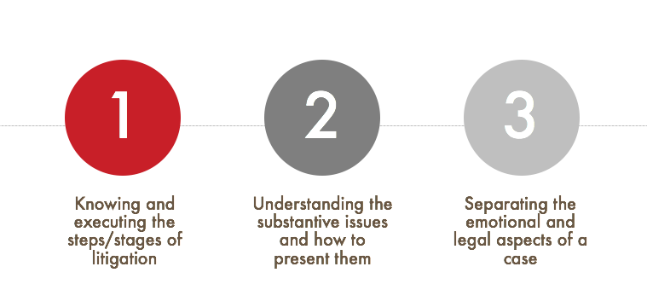
Top Challenges of Self-Representation

Slide 19
Many self-represented litigant participants would have liked …
Legal assistance for the entire case:
“Though some participants recounted negative perceptions of or experiences with attorneys, most would have welcomed an attorney’s assistance for parts of or the whole case …. [T]he desire for legal advice or representation was substantial among CWC litigant participants, with more than 85% of those commenting on the issue expressing a desire for such legal assistance.” – Cases Without Counsel research report
Help with:
Navigating processes/procedures
Forms/paperwork
Guidance on substantive issues
Trial preparation
Evidence presentation
Courtroom advocacy

Slide 20
Self-Represented Litigant Strategies
“The most common strategy participants cited for obtaining legal advice was taking advantage of initial or periodic consultations—whether free or paid. Participants described using consultations for guidance, strategy, and document review, suggesting some creativity in exploring non-traditional means of securing legal services.”
– Cases Without Counsel research report

Slide 21
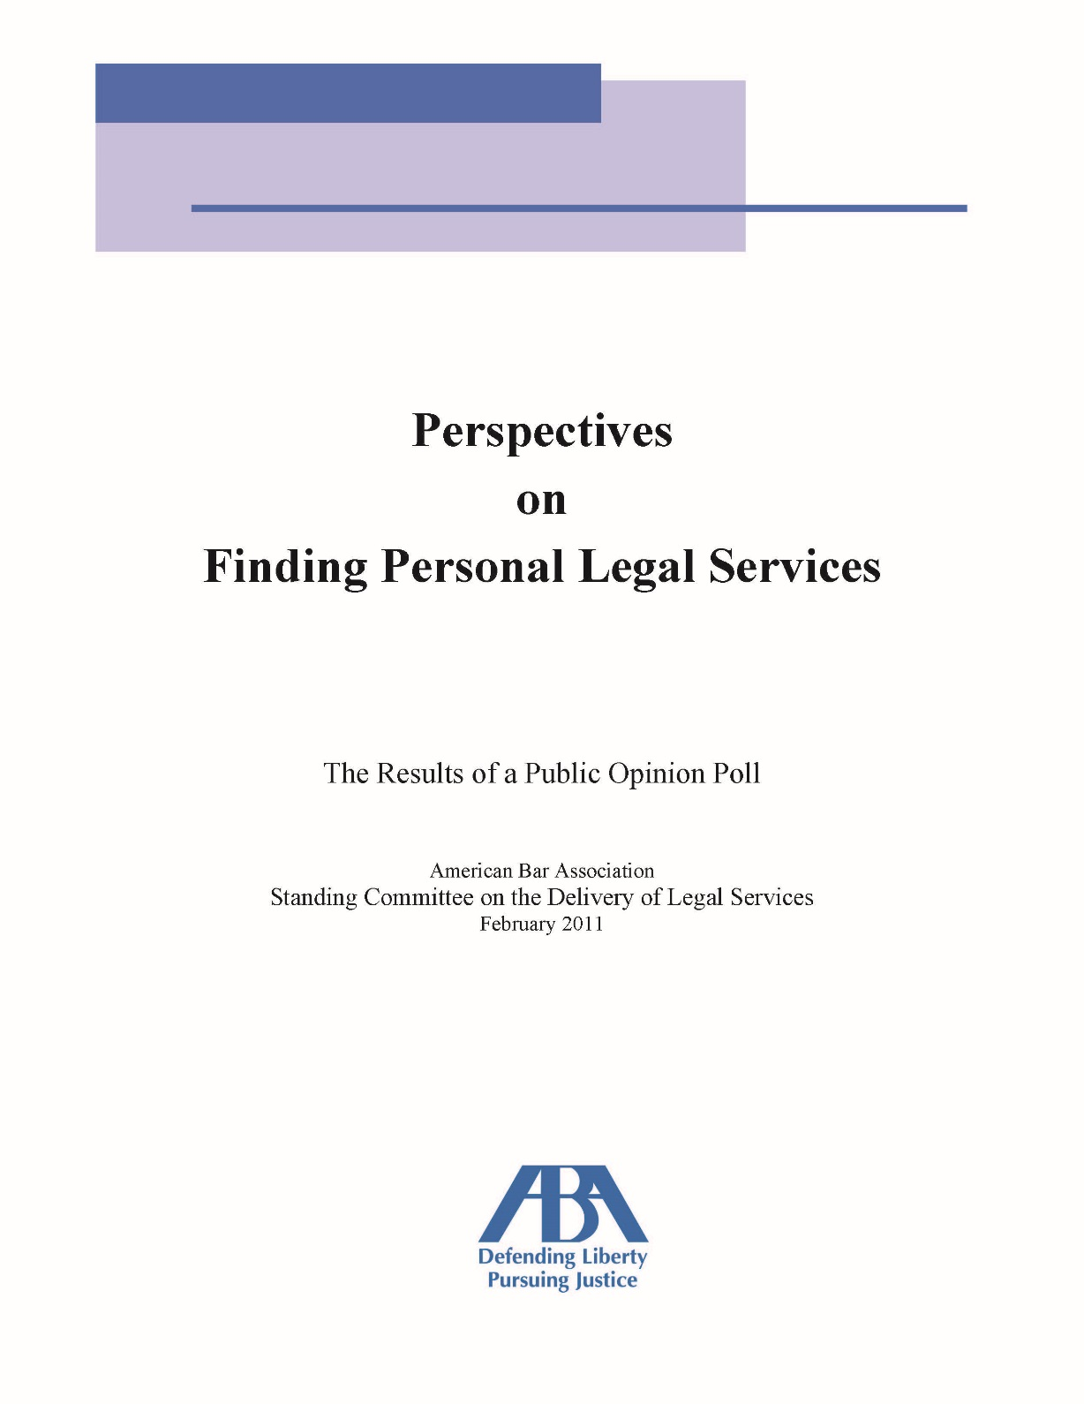

Slide 22
Familiarity with Unbundling

Slide 23
Likelihood of Talking to Lawyer about Unbundling

Slide 24
Importance of Providing Unbundling by Income

Slide 26
Unbundled Percentage of Caseload

Slide 27
Unbundling Use by Practice Size

Slide 28
Perspectives on Unbundling
In your opinion, which of the following are reasons attorneys don’t offer unbundled legal services as part of their practice?
Belief it wouldn’t work for much of their practice
Worry it would expose them to more malpractice claims
Concern that unbundling may be unethical
Prospective clients are not interested in unbundled legal services
Unbundled cases do not produce enough revenue
Difficulty getting enough clients to make unbundling worthwhile
Firm does not permit unbundling

Slide 29
Why They Don’t Unbundle…

Slide 30
From Those Who Do Unbundle…

Slide 31
What Would Encourage [More] Unbundling?
More guidance/clarity concerning ethical obligations for unbundled matters
Sample limited-scope agreements
1
5
More guidance/clarity concerning malpractice exposure for unbundled matters
Nothing. Unbundling is just not in my future
2
6
More guidance/clarity concerning court procedures for unbundled matters
Information to better understand fee structures for unbundled legal services
3
7
Programs to connect you with prospective clients interested in unbundled legal services
Opportunities to network with lawyers who unbundle
4
8

