Slide 1
Decision Makers and Enabling Rules Changes that clarify the practitioner’s path
Moderator: Brittany Kauffman, IAALS
James C. Coyle, Office of Attorney Regulation Counsel, Colorado Supreme Court
Will Hornsby, ABA Standing Committee on the Delivery of Legal Services
Danielle Hirsch, Illinois Supreme Court Access to Justice Commission
Heather K. Kelly, Gordon Rees

Slide 2
TYPES OF UNBUNDLING:
Ghostwriting: when an attorney provides drafting assistance in preparing court documents for a pro se litigant without entering an appearance.
Limited Court Appearance: when an attorney enters an appearance on behalf of a client in court or at mediation.
Other Discrete Tasks: when an attorney provides assistance, such as drafting correspondence and negotiating.

Slide 3
Model Rule of Prof’l Conduct R. 1.2(c)
A lawyer may limit the scope of the representation if the limitation is reasonable under the circumstances and the client gives informed consent.
Informed Consent Defined (Model Rule of Prof’l Conduct R. 1.0(e))
"Informed consent" denotes the agreement by a person to a proposed course of conduct after the lawyer has communicated adequate information and explanation about the material risks of and reasonably available alternatives to the proposed course of conduct.

Slide 4
Model Rule of Prof’l Conduct R. 1.2 Comments:
[5] Legal representation should not be denied to people who are unable to afford legal services, or whose cause is controversial or the subject of popular disapproval. By the same token, representing a client does not constitute approval of the client's views or activities.

Slide 5
Model Rule of Prof’l Conduct R. 1.2 Comments:
[7] Although this Rule affords the lawyer and client substantial latitude to limit the representation, the limitation must be reasonable under the circumstances. If, for example, a client's objective is limited to securing general information about the law the client needs in order to handle a common and typically uncomplicated legal problem, the lawyer and client may agree that the lawyer's services will be limited to a brief telephone consultation. . . . Although an agreement for a limited representation does not exempt a lawyer from the duty to provide competent representation, the limitation is a factor to be considered when determining the legal knowledge, skill, thoroughness and preparation reasonably necessary for the representation. See Rule 1.1.

Slide 6
Model Rule of Prof’l Conduct R. 1.2 Comments:
[8] All agreements concerning a lawyer's representation of a client must accord with the Rules of Professional Conduct and other law. See, e.g., Rules 1.1, 1.8 and 5.6.

Slide 7
Colorado Lawyers:
Colo. R. Prof’l Conduct 1.2(c)
A lawyer may limit the scope or objectives, or both, of the representation if the limitation is reasonable under the circumstances and the client gives informed consent. A lawyer may provide limited representation to pro se parties as permitted by C.R.C.P. 11(b) and C.R.C.P. 311(b).

Slide 8
Model Rule of Prof’l Conduct R. 6.5
(a) A lawyer who, under the auspices of a program sponsored by a nonprofit organization or court, provides short-term limited legal services to a client without expectation by either the lawyer or the client that the lawyer will provide continuing representation in the matter:
(1) is subject to Rules 1.7 and 1.9(a) only if the lawyer knows that the representation of the client involves a conflict of interest; and
(2) is subject to Rule 1.10 only if the lawyer knows that another lawyer associated with the lawyer in a law firm is disqualified by Rule 1.7 or 1.9(a) with respect to the matter.
(b) Except as provided in paragraph (a)(2), Rule 1.10 is inapplicable to a representation governed by this Rule.

Slide 9
Model Rule of Prof’l Conduct R. 6.5, comments:
[3] Because a lawyer who is representing a client in the circumstances addressed by this Rule ordinarily is not able to check systematically for conflicts of interest, paragraph (a) requires compliance with Rules 1.7 or 1.9(a) only if the lawyer knows that the representation presents a conflict of interest for the lawyer, and with Rule 1.10 only if the lawyer knows that another lawyer in the lawyer’s firm is disqualified by Rules 1.7 or 1.9(a) in the matter.

Slide 10
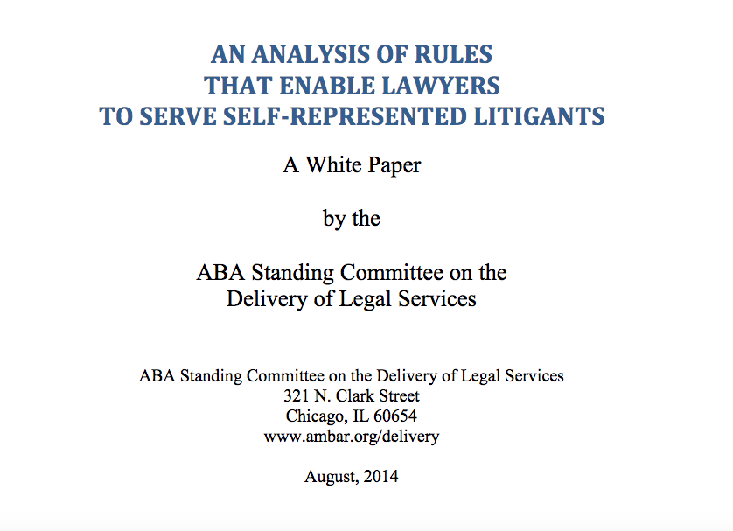

Slide 11
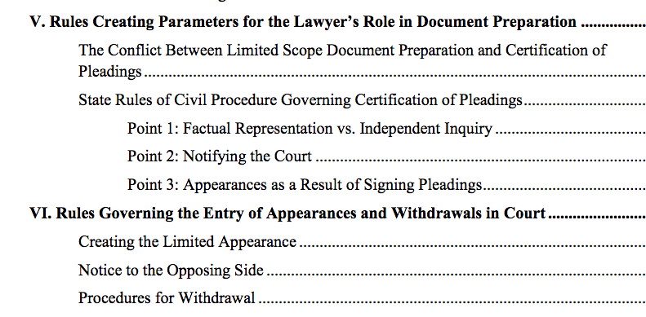

Slide 12
Some states require lawyers who draft pleadings as a discrete function to certify those pleadings, but allow the lawyer to primarily rely on the factual representation of the litigant rather than to conduct an independent inquiry.

Slide 13
Some states are concerned that the courts will be misled if the role of the lawyer in drafting is not revealed to the court. In some jurisdictions, the lawyer’s name and contact information must be disclosed. In others, the court must merely be advised that the litigant had the assistance of a lawyer.

Slide 14
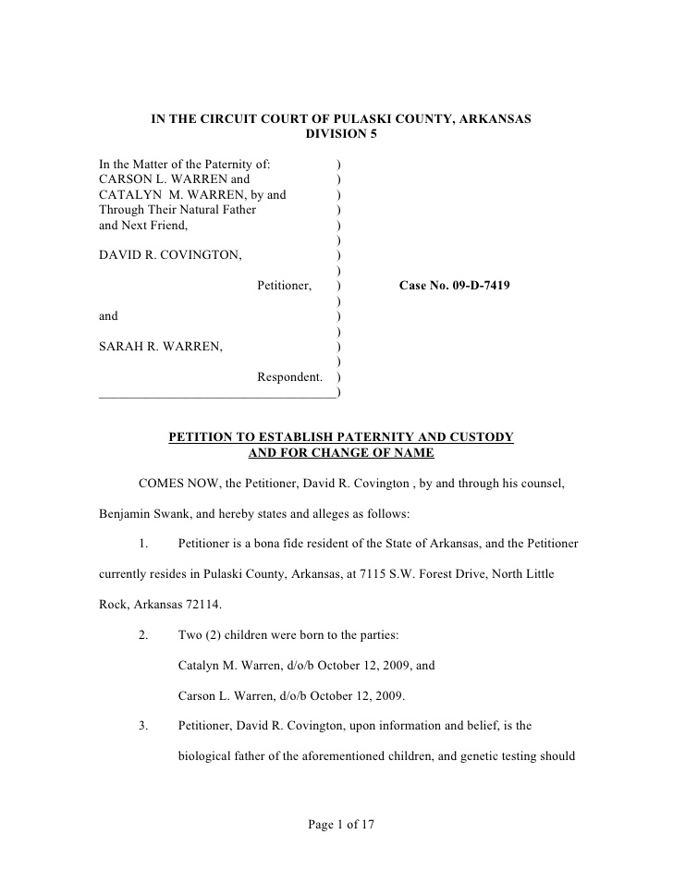
Because a judge can’t tell the difference from this…

Slide 15
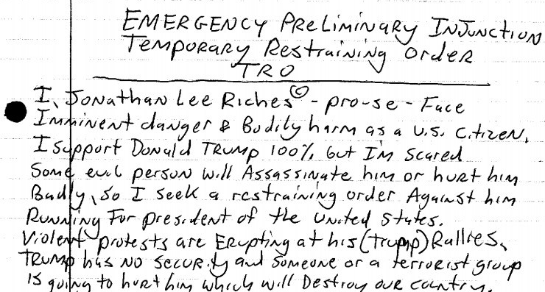
To this…

Slide 16
The obligation to sign pleadings may result in an appearance and where it does, several states have recognized the need to create an exception and preclude the lawyer who is providing limited services from an obligation to provide more expanded services than he or she agreed to provide.

Slide 17
Creating the Limited Appearance . . . . . .
Notice to the Opposing Side . . . . . . . . .
Procedures for Withdrawal . . . . . . . . . .

