Slide 1
Collaboration: What are the opportunities? The Judiciary
Hon. Dina E. Fein, First Justice
Western Division of the Massachusetts Housing Court

Slide 2
Development of LAR in Massachusetts
Convene Stakeholder Groups
Courts
Bar Leaders
Malpractice Carrier
Pilot in Select Probate and Family Courts
Extend to All Probate and Family Courts
Authorize in All Court Departments
Promote LAR and Train Lawyers
Standardize Practices and Forms

Slide 3
Supreme Judicial Court Order Authorizing LAR
Background – LAR permits attorneys to assist a self-represented litigant on a limited basis without undertaking a full representation of the client on all issues related to the legal matter for which the attorney is engaged. After the completion and assessment of a Limited Assistance Representation Pilot Project in the Hampden, Suffolk, and Norfolk Divisions of the Probate and Family Court Department pursuant to a Standing Order dated August 1, 2006, as amended from time to time, the Justices have concluded that limited assistance representation can be of significant benefit in expanding access to justice in the Trial Courts, and should be available in such Divisions and in connection with such matters as each Trial Court Department Chief Justice, in his or her discretion and with the approval of the Chief Justice for Administration and Management, may prescribe.

Slide 4
Supreme Judicial Court Order Authorizing LAR
Limited Assistance Representation may be implemented in any Department of the Trial Court in such Divisions and in connection with such matters as each Trial Court Department Chief Justice, in his or her discretion and with the approval of the Chief Justice for Administration and Management, may prescribe. Notwithstanding any provision to the contrary in any Rule of Court or Standing Order, it is hereby ORDERED that the following procedures shall apply with respect to Limited Assistance Representation.
1. Limited Assistance Representation. A qualified attorney may limit the scope of his or her representation of a client if the limitation is reasonable under the circumstances and the client gives informed consent. An attorney shall not be deemed a "qualified attorney" unless he or she completes an information session on Limited Assistance Representation approved by the Chief Justice of the Trial Court Department in which the attorney seeks to represent a client on a limited basis.

Slide 5
Supreme Judicial Court Order Authorizing LAR
2. Limited Appearance. An attorney making a limited appearance on behalf of an otherwise unrepresented party shall file a Notice of Limited Appearance in the form attached to this Order. The Notice shall state precisely the court event to which the limited appearance pertains, and, if the appearance does not extend to all issues to be considered at the event, the Notice shall identify the discrete issues within the event covered by the appearance. An attorney may not enter a limited appearance for the sole purpose of making evidentiary objections. Nor shall a limited appearance allow both an attorney and a litigant to argue on the same legal issue during the period of the limited appearance. An attorney may file a Notice of Limited Appearance for more than one court event in a case. At any time, including during an event, an attorney may file a new Notice of Limited Appearance with the agreement of the client.
A pleading, motion or other document filed by an attorney making a limited appearance shall comply with Rule 11(a), Mass. R.Civ.P. , and/or cognate Departmental Rules, and shall state in bold type on the signature page of the document: "Attorney of [party] for the limited purpose of [court event]." An attorney filing a pleading, motion or other document outside the scope of the limited appearance shall be deemed to have entered a general appearance, unless the attorney files a new Notice of Limited Appearance with the pleading, motion or other document.
Upon the completion of the representation within the scope of a limited appearance, an attorney shall withdraw by filing a Notice of Withdrawal of Limited Appearance in the form attached to this Order, which notice shall include the client's name, address and telephone number, unless otherwise provided by law. The attorney must file a Notice of Withdrawal of Limited Appearance for each court event for which the attorney has filed a Notice of Limited Appearance. The court may impose sanctions for failure to file such notice.

Slide 6
Supreme Judicial Court Order Authorizing LAR
3. Service. Whenever service is required or permitted to be made upon a party represented by an attorney making a limited appearance, for all matters within the scope of the limited appearance, the service shall be made upon both the attorney and the party. Service upon a party shall be at the address listed for the party in the Notice of Limited Appearance. If the party's address has been impounded by court order or rule, service of process on the party shall be made in accordance with the court order or rule. Service upon an attorney making a limited appearance shall not be required for matters outside the scope of the limited appearance.
4. Assistance in the preparation of documents. An attorney may assist a client in preparing a pleading, motion or other document to be signed and filed in court by the client, a practice sometimes referred to as "ghostwriting." In such cases, the attorney shall insert the notation "prepared with assistance of counsel" on any pleading, motion or other document prepared by the attorney. The attorney is not required to sign the pleading, motion or document, and the filing of such pleading, motion or document shall not constitute an appearance by the attorney.

Slide 7
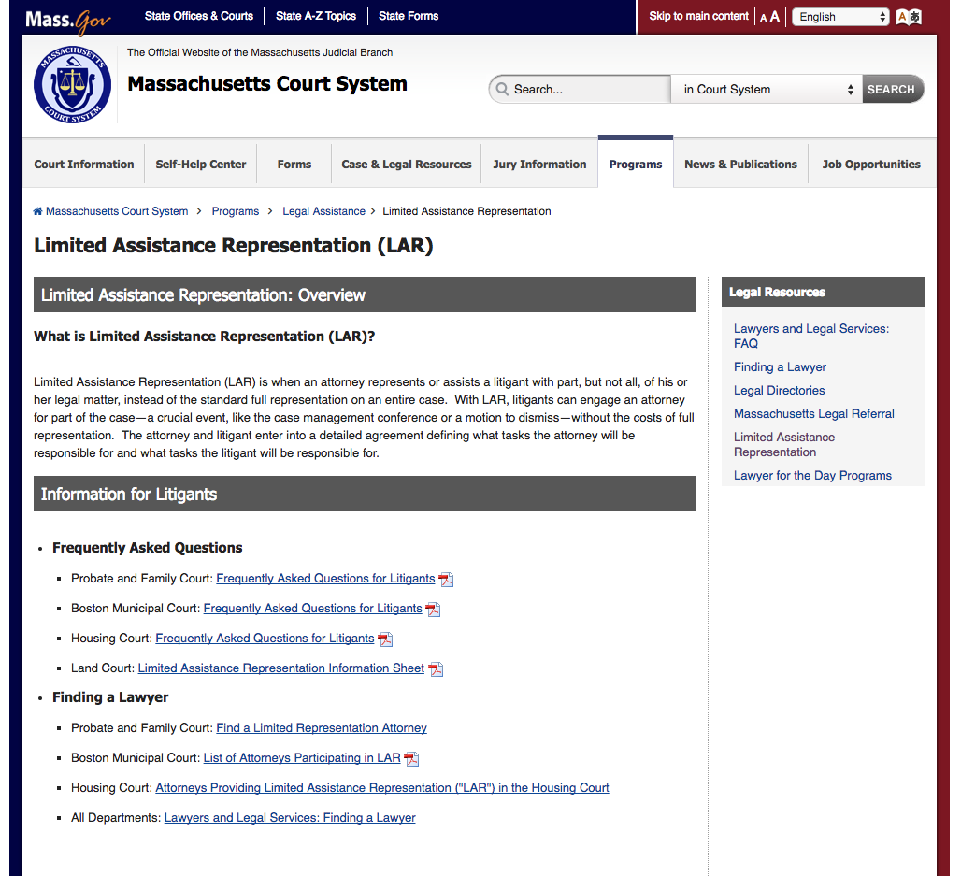
LAR Materials on Court Website:
http://www.mass.gov/courts/programs/legal-assistance/lar-gen.html
Notice of Limited Appearance:
http://www.mass.gov/courts/docs/forms/housing/notice-of-limited-appearance.pdf
List of Attorneys on Website:
http://www.mass.gov/courts/docs/forms/probate-and-family/lar-attorney-listing.pdf

Slide 8
Training and Promotion
Training Manual:
http://www.mass.gov/courts/docs/lar-training-manual.pdf
Training Video:
https://massprobono.org/library/attachment.251369
MCLE:
https://www.mcle.org/product/catalog/code/2160064P01
MBA:
http://calendar.umassd.edu/cal/event/showEventMore.rdo;jsessionid=49121E9E6997B6983D8D993DA79F6174

